Slide 1
ABNORMAL PSYCHOLOGY
SHAHTAJ SHAKIR
LECTURER
FAST NUCES

Slide 2
LEARNING OUTCOME
To enable student to distinguish b/w normal and abnormal behaviors
To enable student to learn what mental disorders are
To enable students to learn about various treatment approaches for psychological disorders

Slide 3
MENTAL HEALTH
According to World Health Organization (WHO):
“Mental Health is a state of well-being in which an individual realizes his or her
own abilities, can cope with the normal
stresses of life, can work productively,
and is able to make a contribution to his or her community”

Slide 4
ABNORMAL PSYCHOLOGY
“A branch of psychology
deals with the abnormal /
pathological mental processes and behaviors”

Slide 5
NORMAL AND ABNORMAL BEHAVIORS How can we distinguish normal from abnormal behavior?

Slide 6
IDENTIFYING ABNORMALITY 4-Ds.
Abnormality as a Sense of Personal Discomfort (Distress)
Deviation from Social Norms
To employ this statistically based approach, that observe highly unusual behaviors that stray far from the norms.
Example: Hearing voices
In this approach, behavior is considered abnormal if it produces a sense of personal distress, anxiety, or guilt in an individual—or if it is harmful to others in some way.
Example: Obsessive Compulsive Disorder

Slide 7

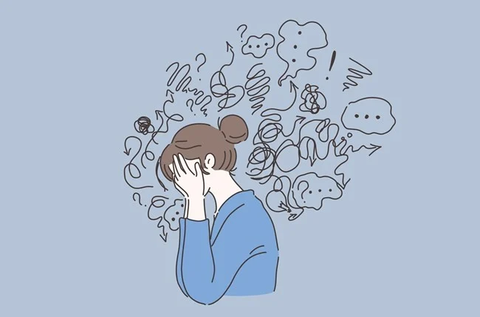
Abnormality as Dysfunctioning
Abnormality as Danger
Disability is an impairment in some important areas of life (work or in personal relationship).
Example: Impact of Substance Use Disorders
Behaviors and feelings that causes interference with life and poses risk of harm.
Example: Paranoid ideation

Slide 8
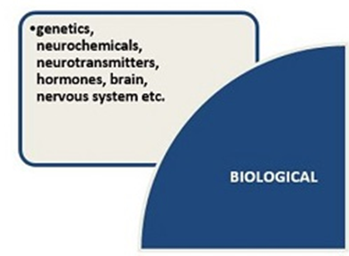
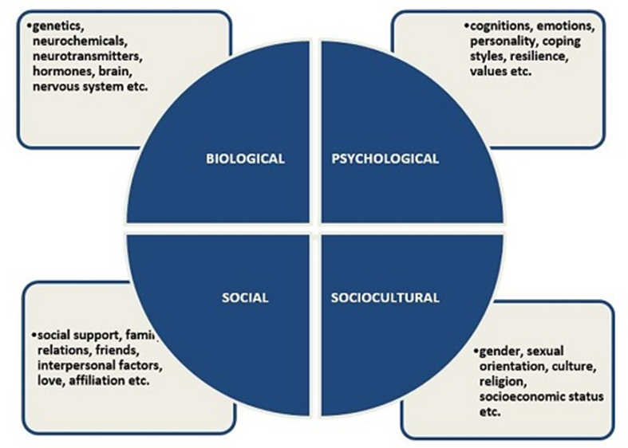
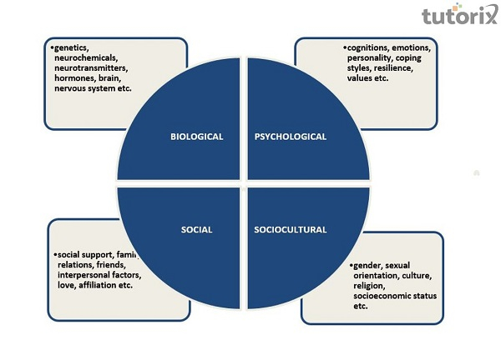
Factors contributing Mental disorders

Slide 9
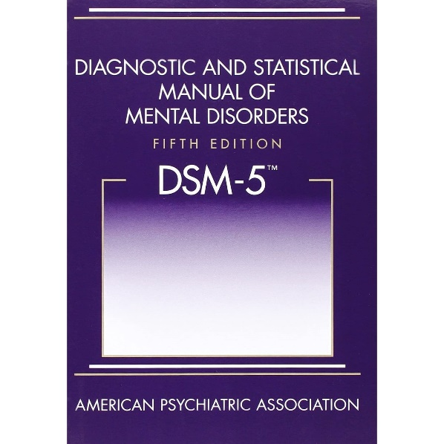
DSM 5
Diagnostic Statistical Manual of Mental Disorders:
Published by the American Psychiatric Association
The big book of disorders.
DSM classifies disorders and
describe the symptoms.
DSM will NOT explain the possible cures.

Slide 10
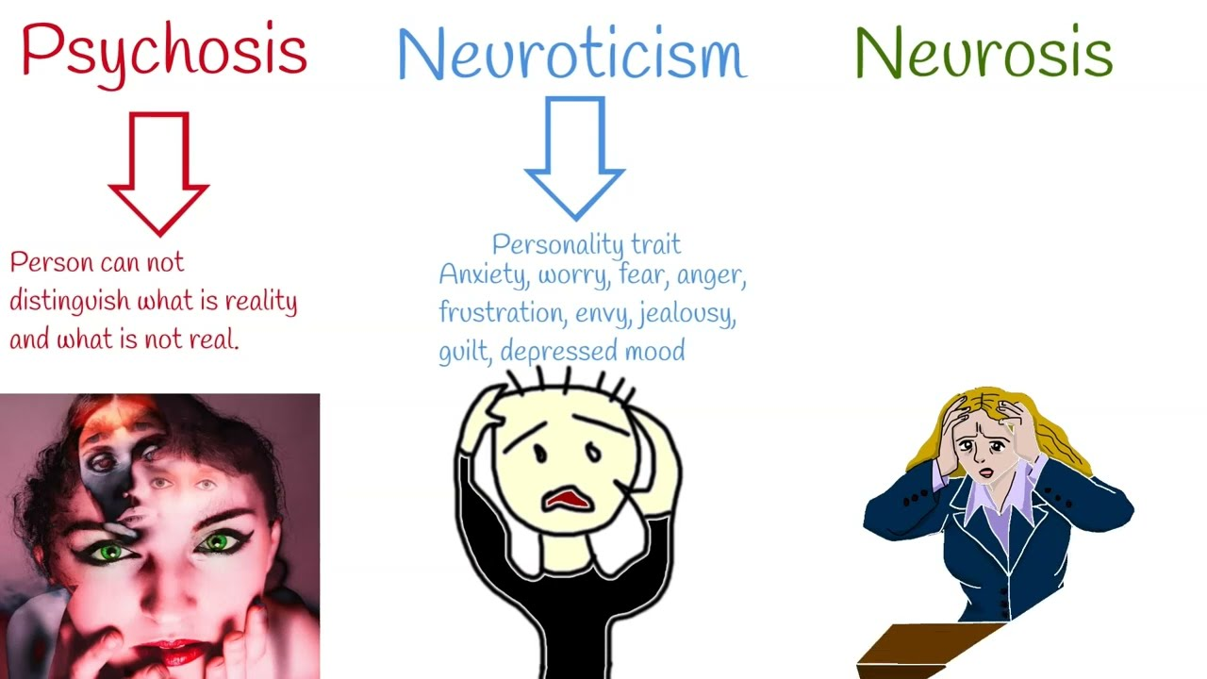
Two Major Classifications Of Mental Disorders
Neurotic Disorders
Distressing but one can still function in society and act rationally.
Psychotic Disorders
Person loses contact with reality, experiences
distorted perceptions.

Slide 11
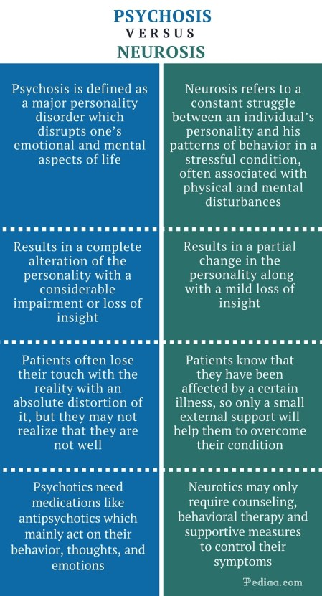
Psychotic Disorders
schizophrenia
brief psychotic disorder
delusional disorder
substance-induced psychotic disorder
Neurotic disorder
Generalized anxiety disorder.
Depression.
Obsessive-compulsive disorder.
Social phobia.
Posttraumatic stress disorder.
Panic disorder.
Antisocial personality disorder.

Slide 12

THE COMMON PSYCHOLOGICAL DISORDERS

Slide 13
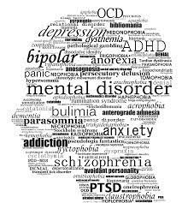
Mental Disorders
According to DSM 5:
““A mental disorder is a syndrome characterized by clinically significant disturbance in an individual's cognition, emotion, regulation or behavior that reflects a dysfunction in the psychological, biological, or developmental processes underlying mental functioning
Mental disorders are usually associated with significant distress or disability in social, occupational or other important activities”

Slide 14
Mental Health Disorders
Panic Disorder
Depression
Schizophrenia
Post-Traumatic Stress Disorder
Obsessive Compulsive Disorder
Bipolar

Slide 15
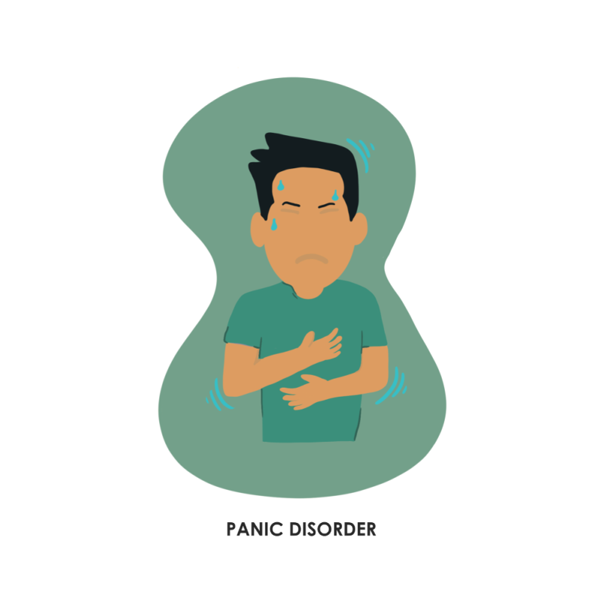
Panic disorder
panic attacks (a sudden episode of intense fear ) occur that last from a few seconds to several hours.
an anxiety disorder where you regularly have sudden attacks of panic or fear.
Unlike phobias, which are stimulated by specific objects or situations, panic disorders do not have any identifiable stimuli
During an attack, anxiety rises to a peak, and an individual feels a sense of impending, unavoidable doom.
Think that they’re losing control, having a heart attack or even dying.
Some people with panic disorder develop a complication called agoraphobia, the fear of being in a situation in which escape is difficult and in which help for a possible panic attack would not be available. In extreme cases, people with agoraphobia never leave their homes

Slide 16
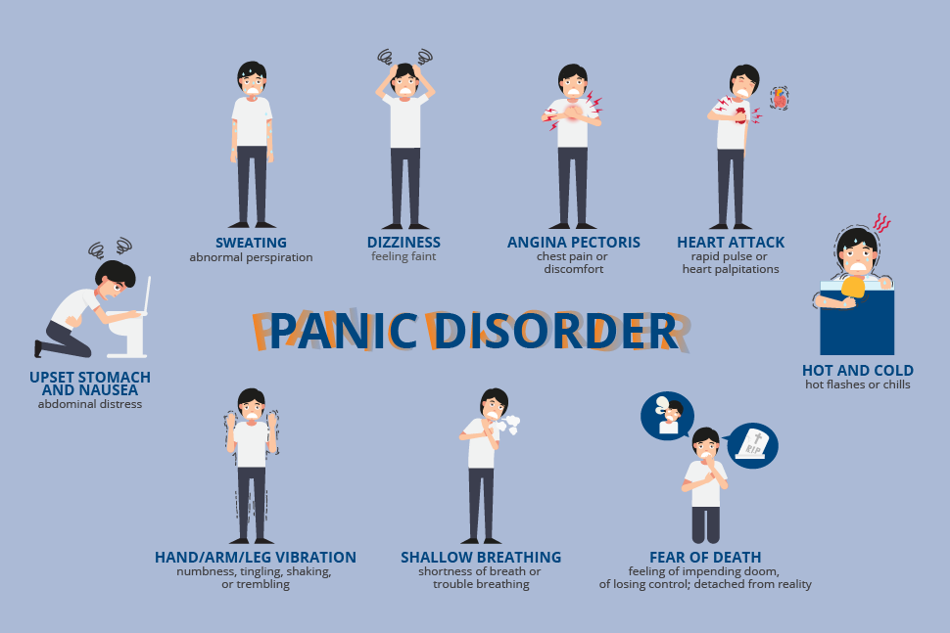

Slide 17
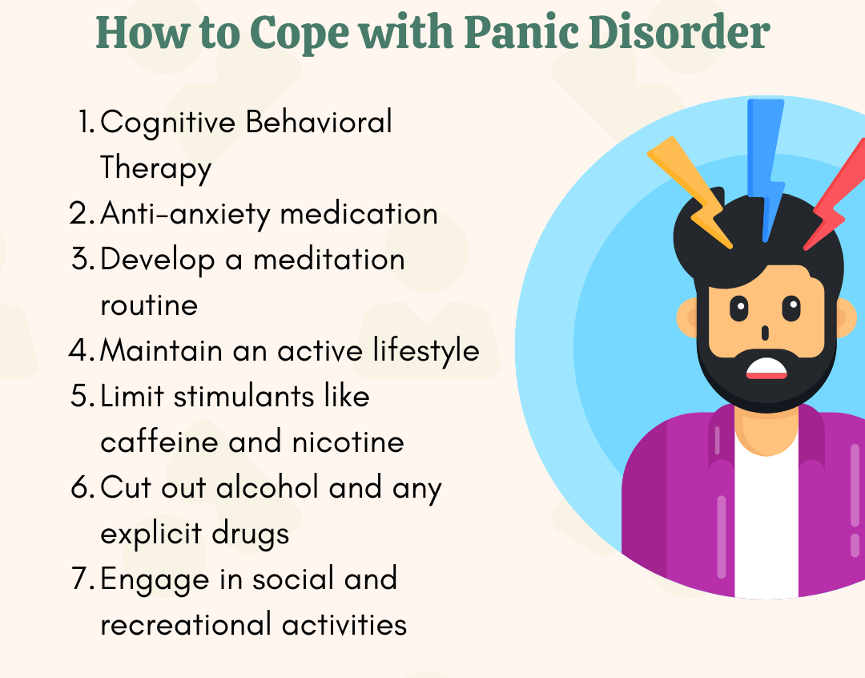

Slide 18
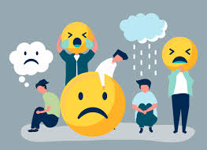
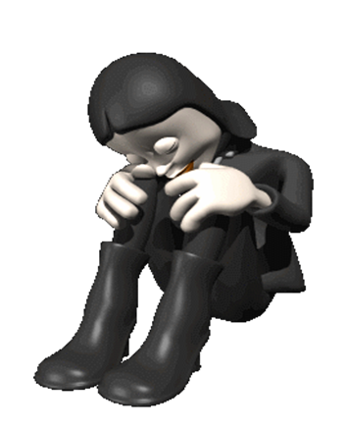
Major Depressive Disorder
Poor concentration or indecisiveness
Recurrent thoughts of death
Duration 2 weeks at least
Clinically significant distress or impairment in social, occupational or other important areas of functioning
Depression is a mood disorder that causes a persistent feeling of sadness and loss of interest. Also called major depressive disorder or clinical depression
People with Major Depressive Disorder experience low mood most of the day, nearly every day
Or loss of interest or pleasure in all or almost all activities
Significant weight loss/weight gain
Sleep disturbance
Fatigue or loss of energy
Feeling worthless
Guilt
even small tasks take extra effort

Slide 19
Treatment for Major Depressive Disorder
Antidepressants
Psychotherapy Cognitive behavioral therapy (CBT)
Exercise. Take a 15- to 30-minute brisk walk every day. ...
Eat healthy foods and drink plenty of water. Some people with depression don't feel much like eating. ...
Express yourself. ...
Don't dwell on problems. ...
Notice good things.

Slide 20
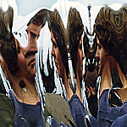
Schizophrenia
Hallucinations (seeing or hearing things that don't exist)
Delusions (false beliefs)
Disorganized Behaviors
Disorganized Speech
Negative Symptoms
In Schizophrenia, severe distortion of reality occurs.
Thinking, perception, and emotion may deteriorate; the individual may withdraw from social interaction; and the person may display bizarre behavior.
6 months period with 1 month of active phase

Slide 21
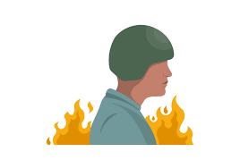
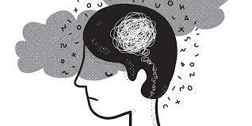
Post-Traumatic Stress Disorder (PTSD)
A disorder that develops in some people who have experienced a shocking, scary, or dangerous event.
Directly experience, witness traumatic events or learn that something bad happened with family member or loved one
Duration 1month
Irritability or anger outburst
Poor concentration
Sleep disturbance
hypervigilance
Experience recurrent, involuntary distressing memories or dreams or flashbacks of traumatic event
Persistence avoidance of stimulus associated with traumatic event

Slide 22
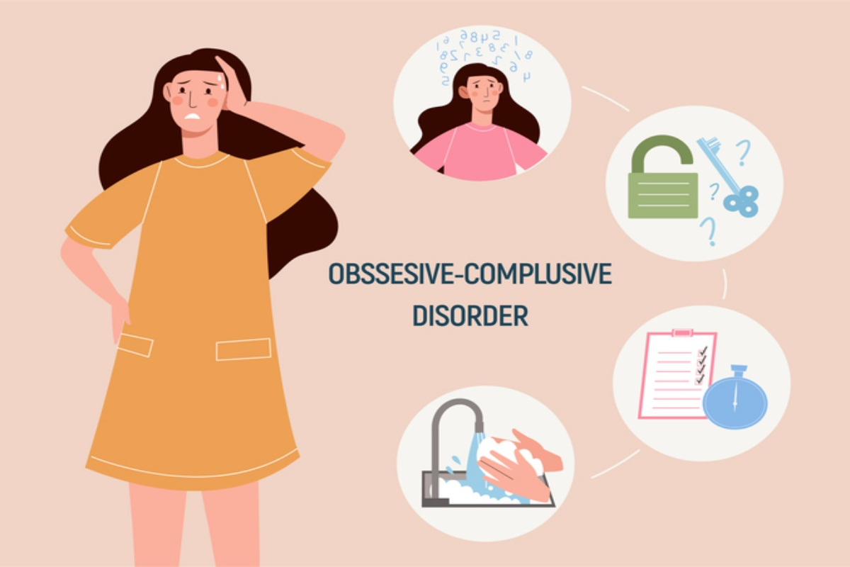
Obsessive Compulsive Disorder
Examples: Repeatedly checking the stove if its turned off, excessive hand washing, counting, repeating words silently, or rituals.
1 hour
An obsession is a persistent, unwanted thought, idea or image that keeps recurring.
People may also experience compulsions, irresistible urges to repeatedly carry out some act that seems strange and unreasonable even to them.
Whatever the compulsive behavior is, people experience extreme anxiety if they cannot carry it out even if it is something they want to stop.

Slide 23
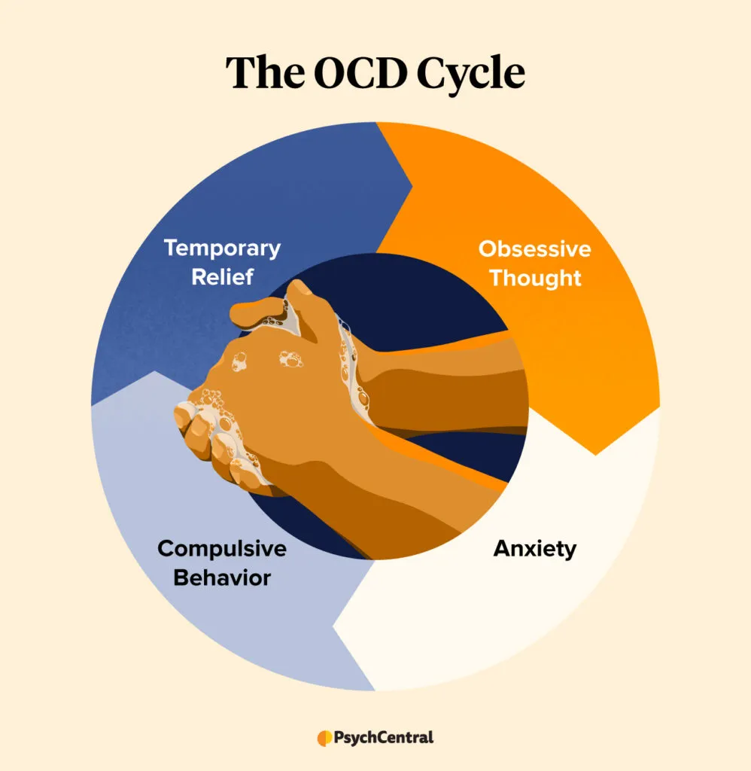

Slide 24
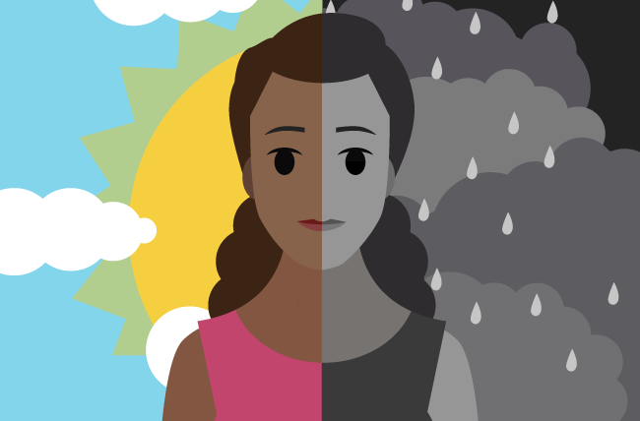
Bipolar Disorder
A group of mood disorders that cause extreme fluctuation in a person’s mood, energy, and ability to function.
People who live with bipolar disorder experience periods of great excitement, over activity, delusions, and euphoria (known as mania) and other periods of feeling sad and hopeless (known as depression).
Emotional highs (mania or hypomania) and lows (depression).
These mood swings can affect sleep, energy, activity, judgment, behavior and the ability to think clearly.
Individuals with bipolar experience an elevated or irritable mood for at least four consecutive days while their depressive episodes last for at least two weeks at a time.

Slide 25


Treatments of Psychological Disorders
Your treatment depends on the type of mental illness you have, its severity and what works best for you. In many cases, a combination of treatments works best.

Slide 26


TREATMENTS
The psychological approach to reducing disorder involves providing help to individuals or families through psychological therapy, including psychoanalysis, humanistic-oriented therapy, cognitive behavioral therapy (CBT), and other approaches.
2. The biomedical approach to reducing disorder is based on the use of medications to treat mental disorders such as schizophrenia, depression, and anxiety, as well as the employment of brain intervention techniques, including electroconvulsive therapy (ECT), transcranial magnetic stimulation (TMS), and psychosurgery.

Slide 27


TREATMENTS
3. The social approach to reducing disorder focuses on changing the social environment in which individuals live to reduce the underlying causes of disorder. These approaches include group, couple, and family therapy, as well as community outreach programs.
The community approach is likely to be the most effective of the three approaches because it focuses not only on treatment, but also on prevention of disorders (World Health Organization, 2004).

Slide 28
THANKS!
Do you have any questions?

